Slide 1
ESOP Exit Process

Slide 2
Exit Eligibility
Please note that you may choose to remain invested even after your exit with no change in the benefits, the leverage and protection mechanisms until the scheme matures. There is no action required for this. The scheme continues to remain active after your exit.
It is also possible to apply for redemption at any point after your exit. The scheme rules specify early redemption of the investment before the 5 year lock in period only in cases of exceptional circumstance. These include:
Termination/resignation/superannuation of the employment contract
Disability of the subscriber
Death of the subscriber
It is not permitted to withdraw from the scheme if your case does fall under one of the categories mentioned above.

Slide 3
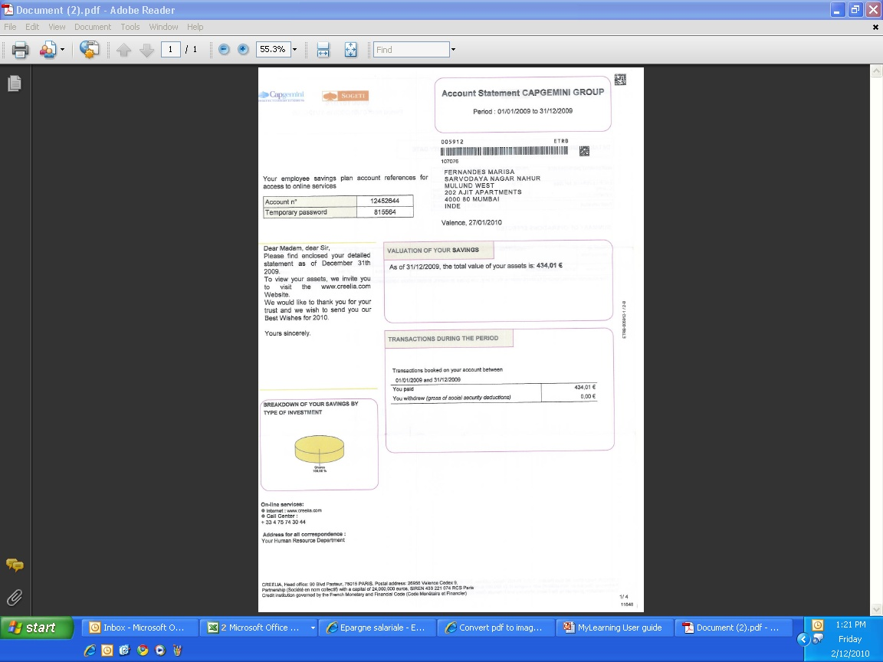
Step 1: Locate Your Account Statement
You have received, by post/email, an account statement, which has your investment details such as your account number and temporary password. You will need this to fill In your account number in the redemption/correspondence form (attached with the mail).
NOTE: If you have not received this document- kindly get in touch with Capgemini’s Human Resources Department.
Account Statement

Slide 4
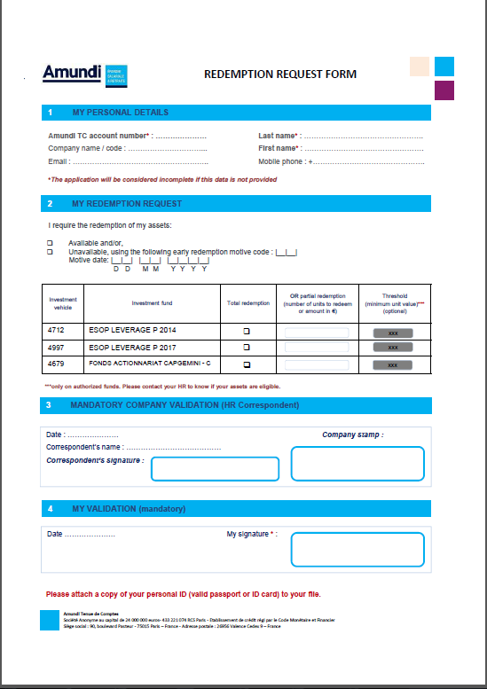
Step 2: Fill in the Redemption/Correspondence Form
‘My Personal Details’ section
Mention ‘Capgemini India Pvt Ltd’ in the company field
“Redemption Request” section
Check Unavailable
Motive Code – Please mention ‘CC’
Motive Date – Your Last working date at Capgemini
Check only the scheme (year) you want to redeem
Do not check the ‘Fonds Actionnariat Capgemini’ section
Partial redemption is not permitted. Leave the partial redemption column blank
Leave the company HR validation section blank
‘My Validation’ section
Mention the date and attest with your signature

Slide 5
Step 3: Mandatory documents for redemption
The following documents are to be sent mandatorily to process the ESOP redemption process. In the absence of any of these documents, the request will not be taken up.
The filled in Correspondence/Redemption Form
Official identification - Copy of the Passport
Letter with bank details (Refer instructions on the next slide – this is where the redemption proceeds will be credited) This should include your → Personal Details: Full name and address → Bank Details: Name and address of bank → Codes: SWIFT Code and IBAN code (IBAN – bank account no; SWIFT – To be provided by your bank)
Bank statements/Cheques will not be accepted.
4) Capgemini India relieving letter

Slide 6
Letter from the bank
The bank that maintains the account must issue a letter with the following details:
Account holder’s name and address
Account number
SWIFT code
The letter may be addressed ‘to whomsoever it may concern’
Please ensure the letter is on the bank’s letter head and that the bank attests the letter
Please do not submit letters with handwritten details
Please do not submit e-mail printouts
The format of the letter is not important. Please ensure all the required details are filled in
The account does not necessarily have to be a salary account. You may provide the details of any account in your name where the redemption proceeds may be credited
The details of the SWIFT code will be available with your bank
Bank statements/Cheques will not be accepted. A letter from the bank with the required details must be provided
In the event the letter is not provided as required, the request will have to be sent again with all the mandatory documents.

Slide 7
Step 4: Send the documents for processing
Please send physical copies of all the mandatory documents by post/courier to the following address.
Saatvik Lahoti / Abhilash Bodanapu Capgemini Technology Services India Ltd,
158 - 162 & 165 - 170 EPIP Phase II, Whitefield,
Bangalore 560066
Karnataka- India
Board: +918041040000
Note: Incomplete/incorrectly filled in redemption documents can not be processed. The redemption request will have to be raised again and all the mandatory documents must be provided again.
For any queries, please write to esopindia.in@capgemini.com

Slide 8
FAQs
How long does it take for the redemption process to complete?
Redemption requests are sent to Amundi on the 20th of every month for processing. After successful submission to Amundi, it may take between 2 - 4 weeks for the redemption proceeds to be wired to your account.
In cases of incomplete requests or incorrectly filled in details, the redemption must be raised with the next cycle.

Slide 9
Thank you

